Slide 1

Group Members
Jamil Ahmad
Daniyal Hussain
Ali Kazim

Slide 2
Direct Memory Access
Direct memory access (DMA) is a method that allows an input/output (I/O) device to
send or receive data directly to or from the main memory, bypassing the CPU to speed
up memory operations.
The process is managed by a chip known as a DMA controller (DMAC).
What is a DMA Controller?
Direct Memory Access uses hardware for accessing the memory, that hardware is called
a DMA Controller. It has the work of transferring the data between Input Output
devices and main memory with very less interaction with the processor. The direct
Memory Access Controller is a control unit, which has the work of transferring data.

Slide 3
DMA Controller Diagram in Computer Architecture
DMA Controller is a type of control unit that works as an interface for the data bus and
the I/O Devices.
DMA Controller has the work of transferring the data without the intervention of the
processors,
processors can control the data transfer. DMA Controller also contains an address unit,
which generates the address and selects an I/O device for the transfer of data. Here we
are showing the block diagram of the DMA Controller.
.

Slide 4
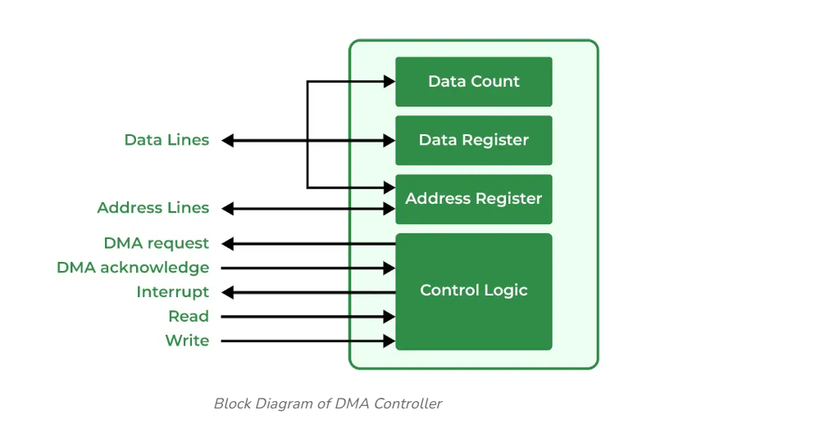

Slide 5
Types of Direct Memory Access (DMA)
There are four popular types of DMA.
• Single-Ended DMA
• Dual-Ended DMA
• Arbitrated-Ended DMA
• Interleaved DMA

Slide 6
Single-Ended DMA: Single-Ended DMA Controllers operate by reading and writing from a single memory address. They are the simplest DMA.
Dual-Ended DMA: Dual-Ended DMA controllers can read and write from two memory addresses. Dual-ended DMA is more advanced than single-ended DMA.
Arbitrated-Ended DMA: Arbitrated-Ended DMA works by reading and writing to several memory addresses. It is more advanced than Dual-Ended DMA.
Interleaved DMA: Interleaved DMA are those DMA that read from one memory address and write from another memory address.

Slide 7
Working of DMA Controller
The DMA controller registers have three registers as follows.
• Address register – It contains the address to specify the desired location in memory.
• Word count register – It contains the number of words to be transferred.
• Control register – It specifies the transfer mode.
Note: All registers in the DMA appear to the CPU as I/O interface registers. Therefore, the CPU can both read and write into the DMA registers under program control via the data bus.

Slide 8
Modes of Data Transfer in DMA
There are 3 modes of data transfer in DMA that are described below.
• Burst Mode: In Burst Mode, buses are handed over to the CPU by the DMA if the whole data is completely transferred, not before that.
• Cycle Stealing Mode: In Cycle Stealing Mode, buses are handed over to the CPU by the DMA after the transfer of each byte. Continuous request for bus control is

Slide 9
generated by this Data Transfer Mode. It works more easily for higher-priority tasks.
• Transparent Mode: Transparent Mode in DMA does not require any bus in the transfer of the data as it works when the CPU is executing the transaction.
Advantages of DMA Controller
• Data Memory Access speeds up memory operations and data transfer.
• CPU is not involved while transferring data.
• DMA requires very few clock cycles while transferring data.

Slide 10
• DMA distributes workload very appropriately.
• DMA helps the CPU in decreasing its load.
Disadvantages of DMA Controller
• Direct Memory Access is a costly operation because of additional operations.
• DMA suffers from Cache-Coherence Problems.
• DMA Controller increases the overall cost of the system.
• DMA Controller increases the complexity of the software.

